Slide 1
Power-Line and Tower Inspection Drone
TEAM NAME: VectorCraft
MEMBERS:
Nandana Doss V
Nikhileswar Pakala
S Bhanu Sanjana
Harshini Balakrishnan

Slide 2
Problem Statement:
Inspect high-voltage lines and towers at close range and report defects such as damaged insulators and loose fittings .
Key Requirements:
Defect Detection: Identify damage using zoom camera or LiDAR.
Autonomous navigation: Plan safe paths around towers and power lines while avoiding obstacles.
Stable flight: Hover reliably even in wind gusts of up to 12 m/s.
Safety: Maintain a 3 m stand-off distance from power lines.
Performance: Achieve 30 minutes of endurance with a 1.5 kg sensor payload.

Slide 3
Significance of our Project
Why is manual power-line inspection difficult?
1. Working at heights
2. High-voltage hazards
3. Time-consuming
4. Difficult access
5. Limited inspection angles
Why is a drone useful?
Improved safety
Faster inspection
Close-up imaging
Thermal inspection
Obstacle detection
Team VectorCraft proposes a hexacopter carrying RGB zoom and thermal cameras, along with LiDAR. The drone aims to inspect components from a nominal distance of 4 m while maintaining a proposed hard minimum of 3 m.

Slide 4
How we read each requirement
Requirement | Our reading
EMI-resistant avionics | Compass, GNSS and telemetry must work within a few meters of 50 Hz conductors and steel towers.
Hover in 12 m/s gusts | We hold position, not just attitude. Range to the nearest conductor must never drop under 3.0 m.
3 m stand-off | A minimum distance. We fly 4.0 m nominal so a gust has 1.0 m of room.
30 min endurance | Hover and slow inspection with 20 % battery reserve left.
1.5 kg payload | RGB zoom camera, thermal camera, 2D LiDAR, gimbal and mounts, all inside 1.5 kg.
Obstacle avoidance | Detect wires, tower members and vegetation early enough to stop.

Slide 5
Avionics selection and placement
Function |  | Placement | EMI measure
Flight controller + IMU |  | Damped plate at the centre of gravity | Metal case, shielded cables, away from ESC power leads
Navigation 1: dual-antenna GNSS with RTK |  | Two antennas on carbon booms either side of the mast, 0.8 m apart, above the top plate | Antennas away from power wiring, CAN link
Navigation 2: optical flow |  | Bottom plate, facing straight down | Short cable, digital bus
Navigation 3: industrial IMU |  | Rigid plate beside the flight controller, near the CG | Its magnetometer is turned off
Obstacle and stand-off |  | Front of the pod, scan plane vertical along the heading | Optical, shielded cable
Payload |  | Pod below the frame on rubber dampers, quick-release slide-in | Own filtered DC-DC supply, shielded video lines
Companion computer |  | Inside the hub, shielded | Own regulator, heartbeat to the flight controller
Links |  | Antennas on the arms, away from GNSS | Two independent bands
Power |  | Battery on the centreline | Star ground, twisted pairs, ferrites

Slide 6
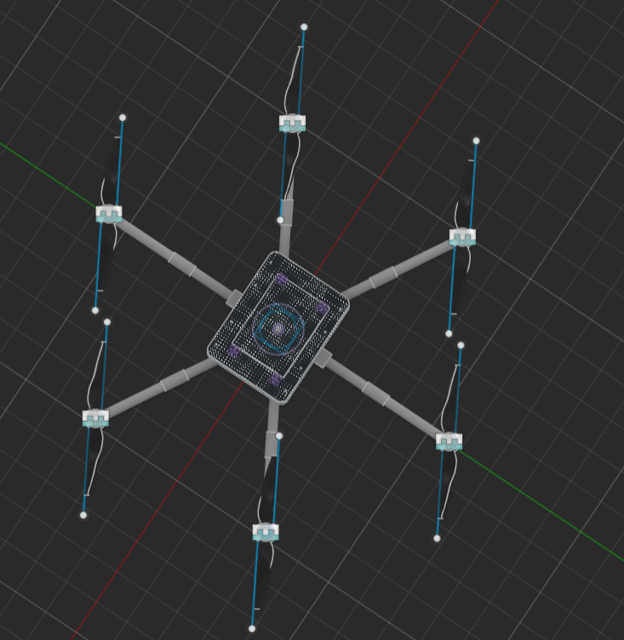
Hexacopter airframe built for gusts and live-line work
Layout: hexacopter, X-layout, six 20 in props, about 1.63 m tip to tip.
Why six motors: it can lose one motor and still land under control, which supports the failsafe case near live conductors.
Gust rejection: thrust-to-weight of 2, low frontal area, streamlined fairing and a CG kept close to the thrust plane. Estimated tilt in a 12 m/s gust is about 13°.
Insulating structure: carbon fibre inboard, glass fibre (GFRP) for outer arms, legs and masts, because carbon conducts.
Compact core: three plates, 340 × 260 mm, with a battery bay below and a shielded avionics bay above.

Slide 7
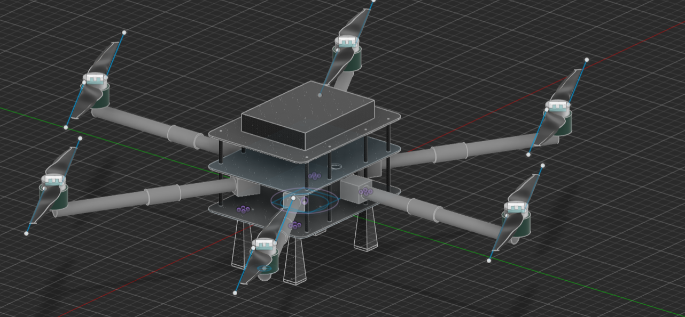
Vertical stack: quick-release payload plate and gimbal below, battery bay, shielded avionics bay, then GNSS stands above.
EMI-aware placement: two GNSS antennas on GFRP stands 300 mm apart for dual-GNSS heading, since a compass is unreliable near power lines. ESCs and power wiring stay low and central, away from the antennas.
Balance: the battery tray slides about ±40 mm to trim the CG. Mass and CG are read from the model: about 6 kg total and CG within about 10 mm of the centre.
Modularity: the camera and LiDAR payloads swap on the same plate, and the electronics were designed to fit keep-out volumes agreed with the team (the interface sheet).

Slide 8
Solving the EMI problem
Why we drop the compass for yaw: the field of a long straight conductor is B = μ₀I / (2πr) . At 3 m we get 13.3 µT at 200 A, 33.3 µT at 500 A and 66.7 µT at 1000 A. Earth's field is about 45 µT, so a heavily loaded line disturbs a magnetometer as much as the signal it measures. A balanced three-phase line partly cancels (about 44.2 µT at 1000 A with 4 m phase spacing, our assumption), and the field is 50 Hz AC with steel-tower distortion on top, so we treat it as an uncertainty, not a fixed offset.
Wiring: power and signal wires are kept apart, GNSS and ESC cables are not routed together, sensor lines go through shielded tubes away from the power distribution board, and we use ferrites and filtering on payload and radio leads.
CAN bus: GNSS and IMU use DroneCAN. Differential signalling rejects noise that couples into both wires the same way.
Links: the 2.4 GHz link sits well above the frequencies where corona noise is strongest, and a second band is kept as backup.

Slide 9
Fail-safe mechanism
Trigger | Immediate action | Then
Pilot override | Manual control always has priority over any automatic mode. | Pilot flies on live video. Automatic retreat is on a switch.
LiDAR invalid more than 0.3 s | Stop along-line motion, hold on GNSS/IMU for up to 3 s. | Retreat along the recorded backup path to a staging point 10 m away.
RTK lost | Slow to 0.3 m/s, pause image capture. Range still comes from LiDAR. | If no fix in 30 s, retreat to staging.
GNSS heading lost | Hold yaw on the gyros, no compass fallback near lines. | Retreat to staging, then land at a safe zone.
GNSS and LiDAR both lost | Slow level back-away along the reverse heading for about 5 s. | Hand control to the pilot. No landing or loitering near the line.
Control link lost | Retreat along the recorded backup path, hold 10 s. | Return by a pre-planned corridor above the tower top plus margin.
Battery 30 % / 20 % | 30 %: finish the span, then retreat. 20 %: retreat now. | Fly the corridor home. 20 % is about 58 Wh, over 7 min of hover.
Motor or ESC fault | Retreat at once on the remaining five rotors. | Land at the nearest marked area 10 m from any conductor.
Wind or tilt limit | Tilt over 15° or range error over 0.8 m: abort and retreat. | Resume only if the wind estimate drops.
EKF health alarm | Stop, retreat, hand over to the pilot. | Land only at a marked safe zone.

Slide 10
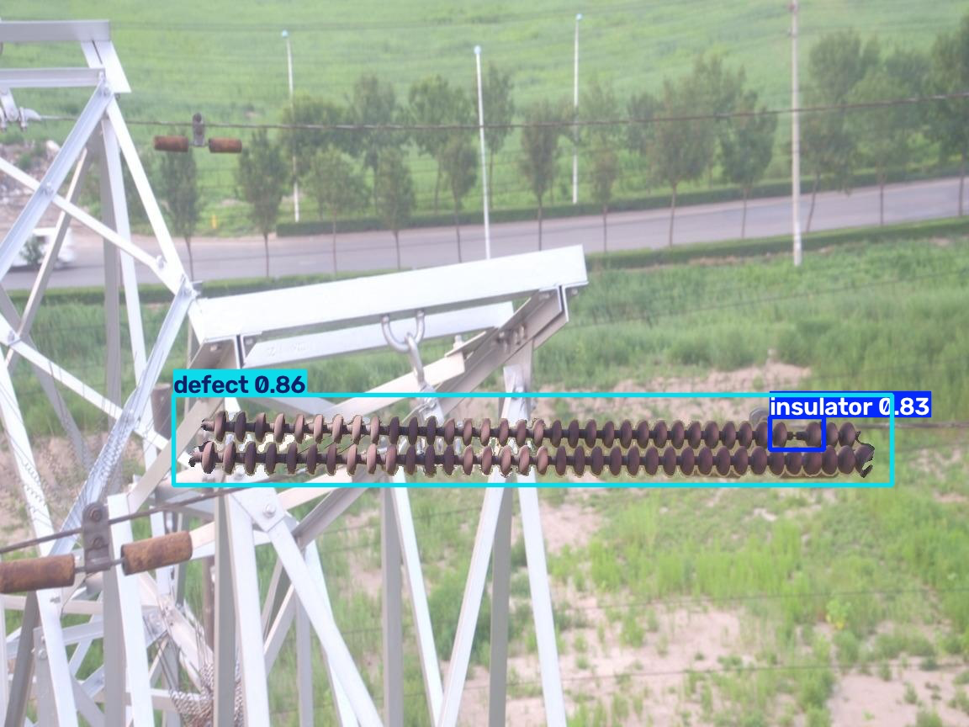
Detection of defects

Slide 11
YOLO-Based Insulator and Defect Detection
We trained a custom YOLO11n object-detection model to identify two classes in transmission-line images: *insulators and defects*. The trained model was saved⁠ and used to perform predictions on test images.
During testing, the model generated bounding boxes around detected objects and displayed confidence scores for each prediction. For example, in one test image, it detected a defect with a confidence score of *0.86 (86%)* and an insulator with a confidence score of *0.83 (83%)*.
The prediction results were saved for visual inspection, allowing us to examine the detected regions and assess whether the model's predictions matched the images.
This work demonstrates the use of computer vision for automated transmission-line component inspection. Further testing with correctly labelled images would be required to measure detection accuracy and reliability.

Slide 12

Path planning
Path Planning & Obstacle Avoidance
Coverage Planning: Represents towers as nodes and power lines as edges; DFS helps determine an efficient inspection sequence.
A* Path Planning: Calculates routes to inspection targets while avoiding known obstacles.
Dynamic Obstacle Avoidance: LiDAR detects nearby obstacles, while cameras assist in bird detection and route replanning.
Workflow: Plan inspection order → Navigate using A* → Detect obstacles → Replan if required → Complete inspection.
Safety: Maintains a minimum 3 m stand-off distance, subject to sensor accuracy and validation through simulation and testing.

Slide 13
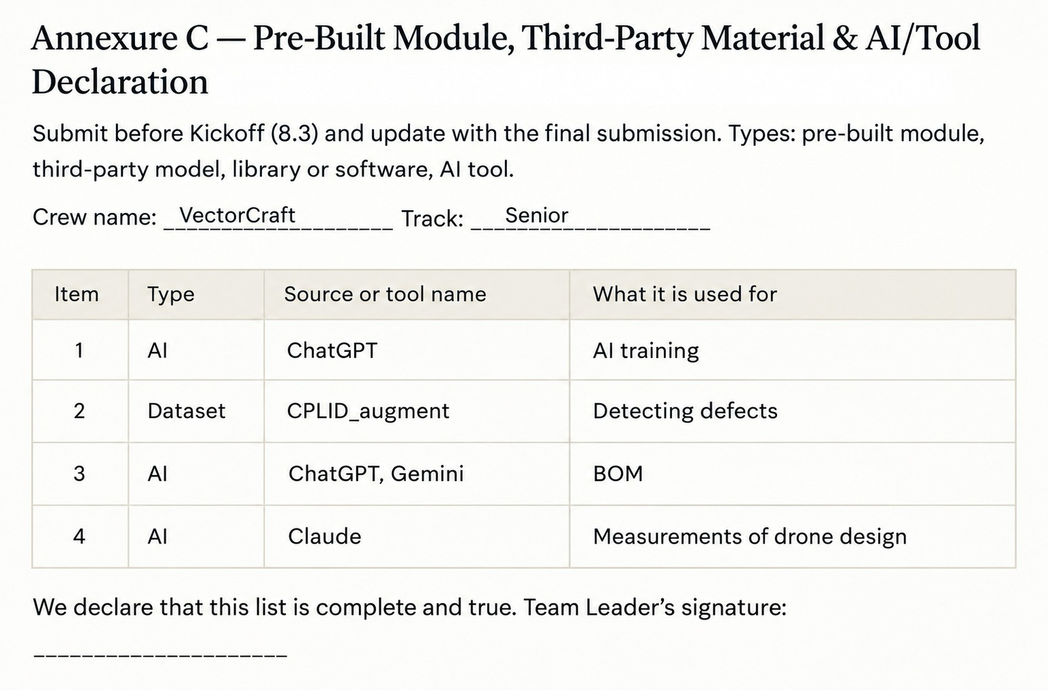

Slide 14
Conclusion
The proposed drone system enables efficient and safer inspection of transmission towers and power lines.
Integration of LiDAR, thermal imaging, and intelligent path planning improves obstacle detection and inspection accuracy.
Autonomous navigation reduces manual effort and supports reliable fault detection.
Further simulation and field testing will help validate system performance and operational safety.

